Slide 1
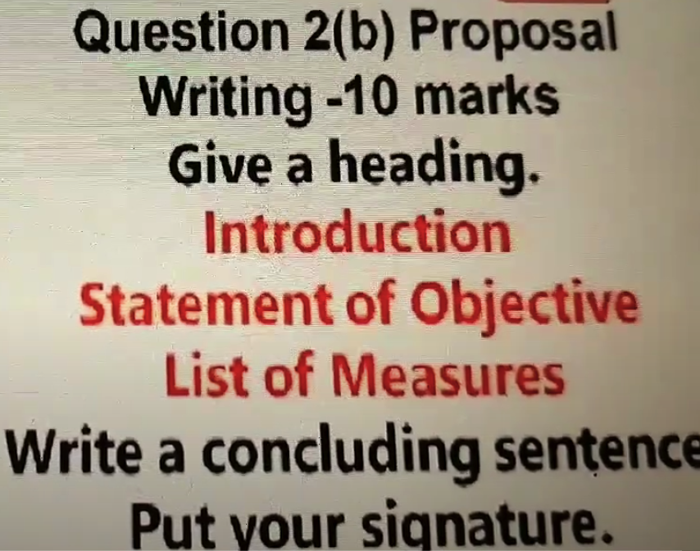

Slide 2
As the president of the Student Council, you want to organize a newspaper collection programme. Write a proposal to your
Principal stating the measures that you would take for an effective outcome of the programme.
PROPOSAL FOR NEWSPAPER COLLECTION PROGRAMME (Title in the centre of the Page)
Introduction: We propose to organize a newspaper collection programme for a month to raise funds and contribute to
Missionaries of Charity for social welfare. ( 2 points- WHAT:)
(Begin with We propose and follow the question...with 2 points)
Statement of Objective: The programme will help students to learn to contribute/donate for social causes and inculcate values
of kindness and generosity in them. ( 2 points- WHY?)
List of Measures: (HOW- STEPS- 5 TO 6 POINTS)
Students from grades 1 to 12 can donate newspaper and participate in this initiative
The collection drive will commence from February 13, 2024 for a month and the antechamber of the library can be
used to store the same
The programme will be supervised by the Student Council and Mr, Saxena, our SUPQW teacher
The newspapers collected to be sold at the end of the month
Funds raised to be donated to the Missionaries of charity.
We hope our proposal will be accepted.
February 12, 2024 Sardeep Desai, President, Student Council

